Slide 1
Android Mobile Application
National E-Gram portal
Gateway to the dynamic Android Application of Panchayats in the country. A component of Panchayat organization, developed under BSC-IT education Project. Which is useful for common man and its helps peoples to get online certificates, you can also access other information like events & tenders

Slide 2
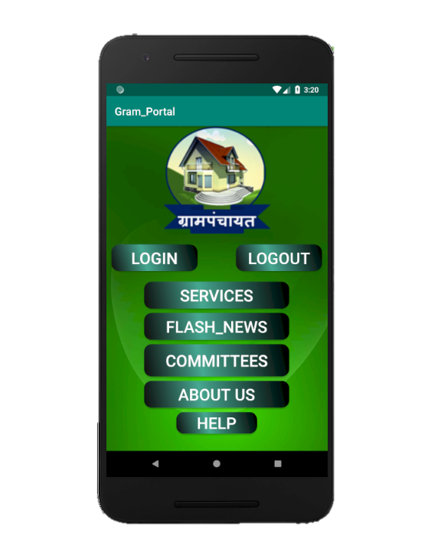
HOME SCREEN
Now you can see the home screen of our application
It will show following option
Like:
1} Services
2} Flash News
3} Committees
4} About Us
5} Log in
6} Help
You can select any Option here like
Log in

Slide 3
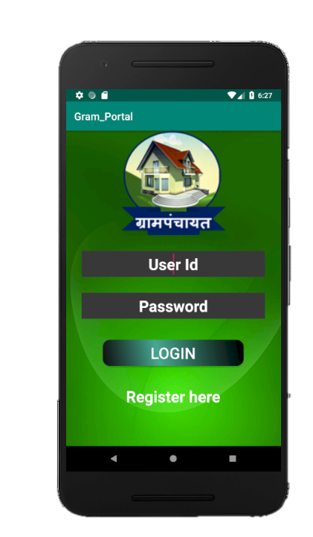
Open Your Account
When you click on you will see these page
Log in
1} In these page you need to enter your Account Id & Password and click on to open your Account
2} if you don’t have any account you can click on and it will show the registration page.
Login
Register Here

Slide 4
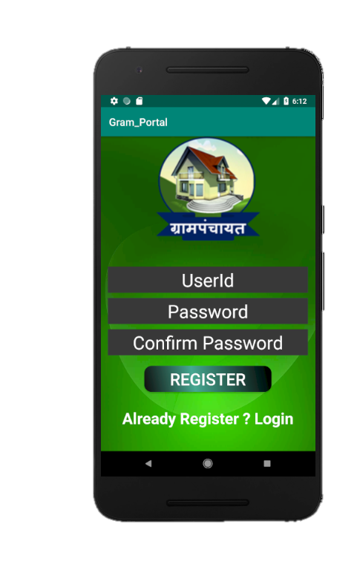
Register Your Account
Now you can Register the required information to create your account
1} your User Id And Password
2} then click on
3} when your account is register you will see a massage box
Register
Your Account Created Successfully

Slide 5
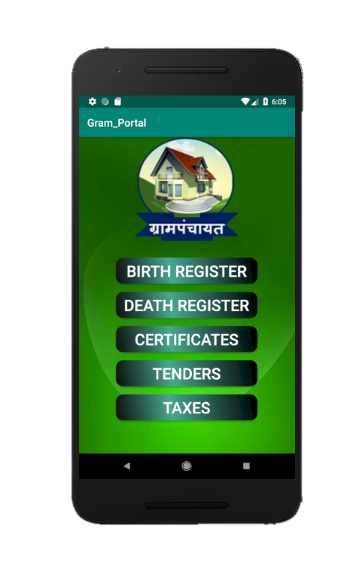
Services Offered
Here you can sent request To Gram panchayat Office for birth registration, Death Registration , Certificates and you can See Tenders and Current News Like Events or Meeting and The facilities provided by the Government for common people Here
and other things is you can paid taxes from this application like water taxes and household Taxes

Slide 6
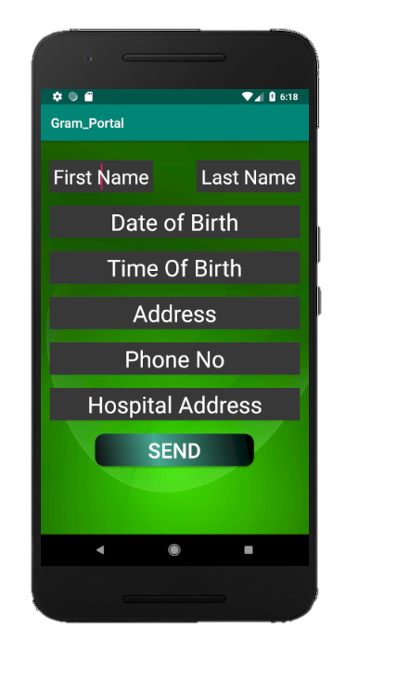
When user login to system if verify the user using username and password which is already saved into database
System compare the entered data and existing data and shows the message as per result
Then user performed operation in the system
1) Register birth :
here the entered data is store in the database give acknowledgement
Certificate creations :
Enter your Required Information And Send Request To The Grampanchayat
Office Through This Application

Slide 7

When user login to system if verify the user using username and password which is already saved into database
System compare the entered data and existing data and shows the message as per result
Then user performed operation in the system
1) Register death :
here the entered data is store in the database give acknowledgement
Certificate creations :
Enter your Required Information And Send Request To The Grampanchayat
Office Through This Application

Slide 8
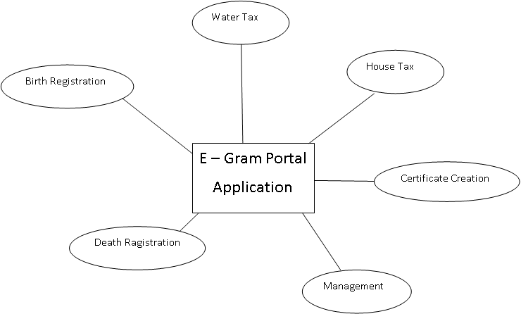
1) Data flow diagram :

Slide 9
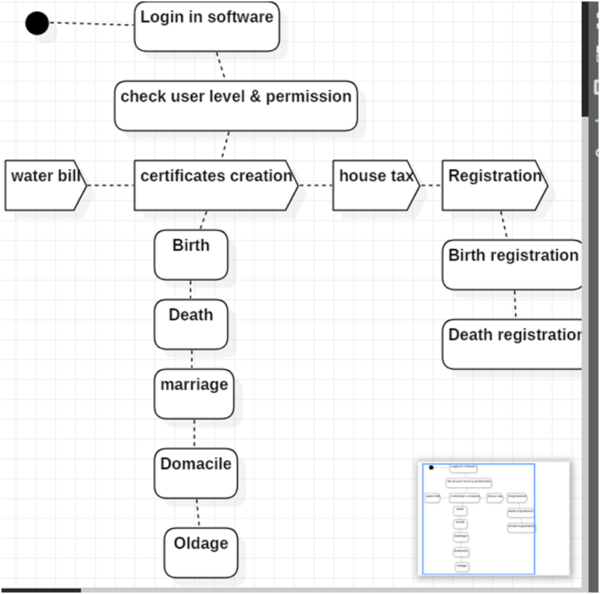
2} Activity Diagram:

Slide 10
3) Use case diagram:

Slide 11
4) Component Diagram:

Slide 12
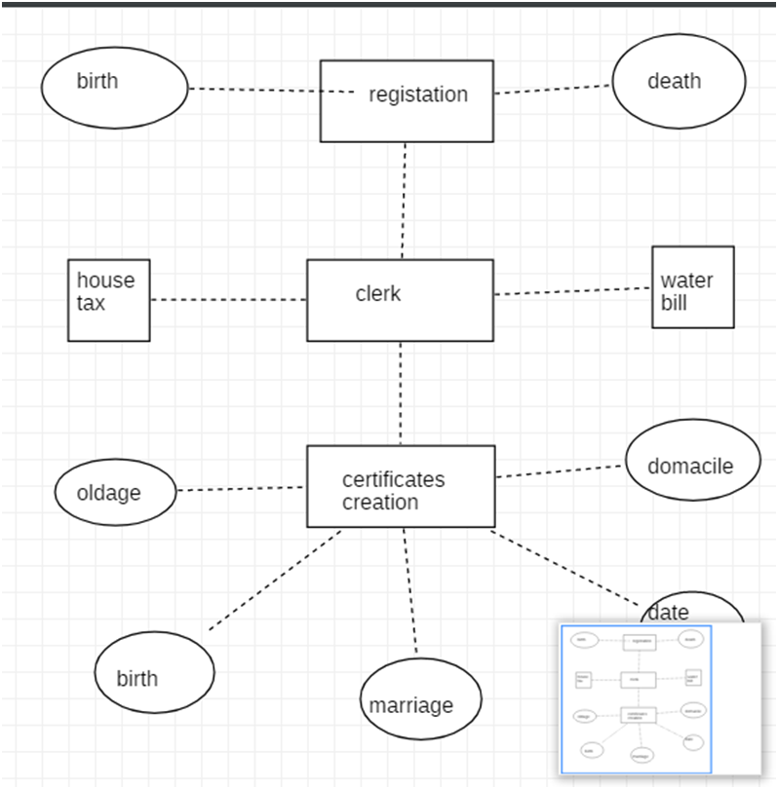
5} ER Diagram:

Slide 13
6) Flow chart diagram of
“E-GRAM APPLICATION”
Start
Start the application
Login to the system using username and password.
Select option from list of services.
If selected to create Birth certificate .
Enter details.
Save and print the certificate.
If selected to register birth and death
Enter input details
Save data.
If select to pay a water / house tax bill
Enter input details
Save and print –the bill
Stop
Log in to User Account
Services
Birth , Death & Other Certificates Register
Save Data
Send A Request
Print
Receive Response
Print
Stop

Slide 14
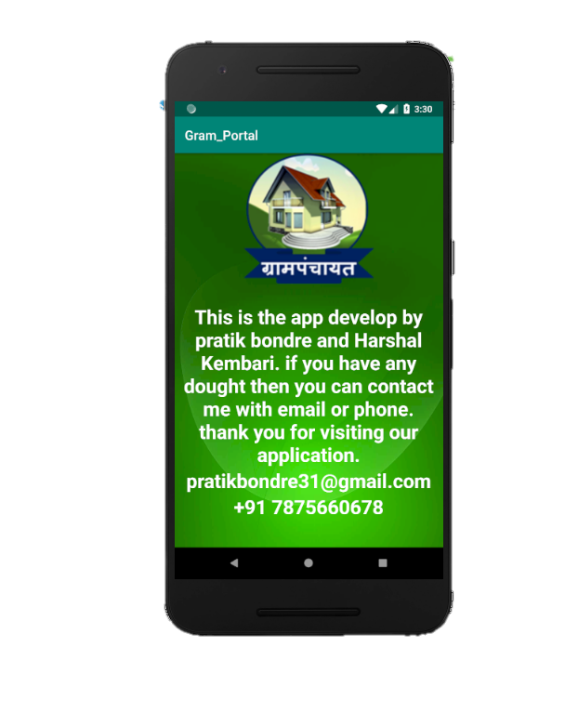
Reference:
1}websites
www.Microsoft.org
www.slideshare.com
www.androidtutoriallpoint.com
www.wikipedia.com
www.youtube.com
www.google.com
2}Books
Advance mobile programing

Slide 15
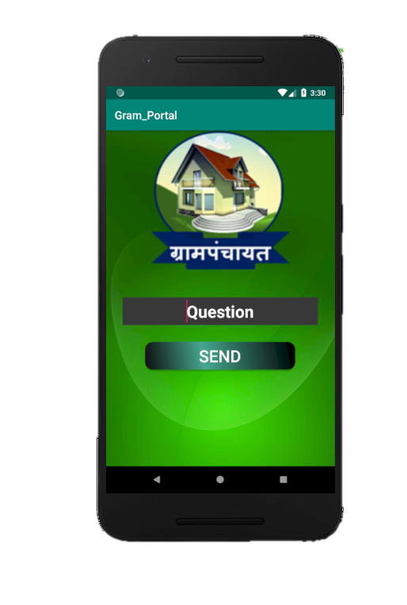
THANK YOU
For
Watching
And I hope You Like this Presentation
Created By Pratik Bondre

